Slide 1
What kind of paid application should a developer develop to the App Store?
An Analysis of Apple App Store Dataset
Aybüke Meydan

Slide 2

Develop A Paid App For App Store
Client:Freelance IOS Developer.
Problem:Develop an app in the preferred size, price and category

Slide 3
METHODOLOGY
Find the profittable category
SERVICES
Counting the paid app category
Decide size and price
An Analysis of Apple App Store Dataset

Slide 4
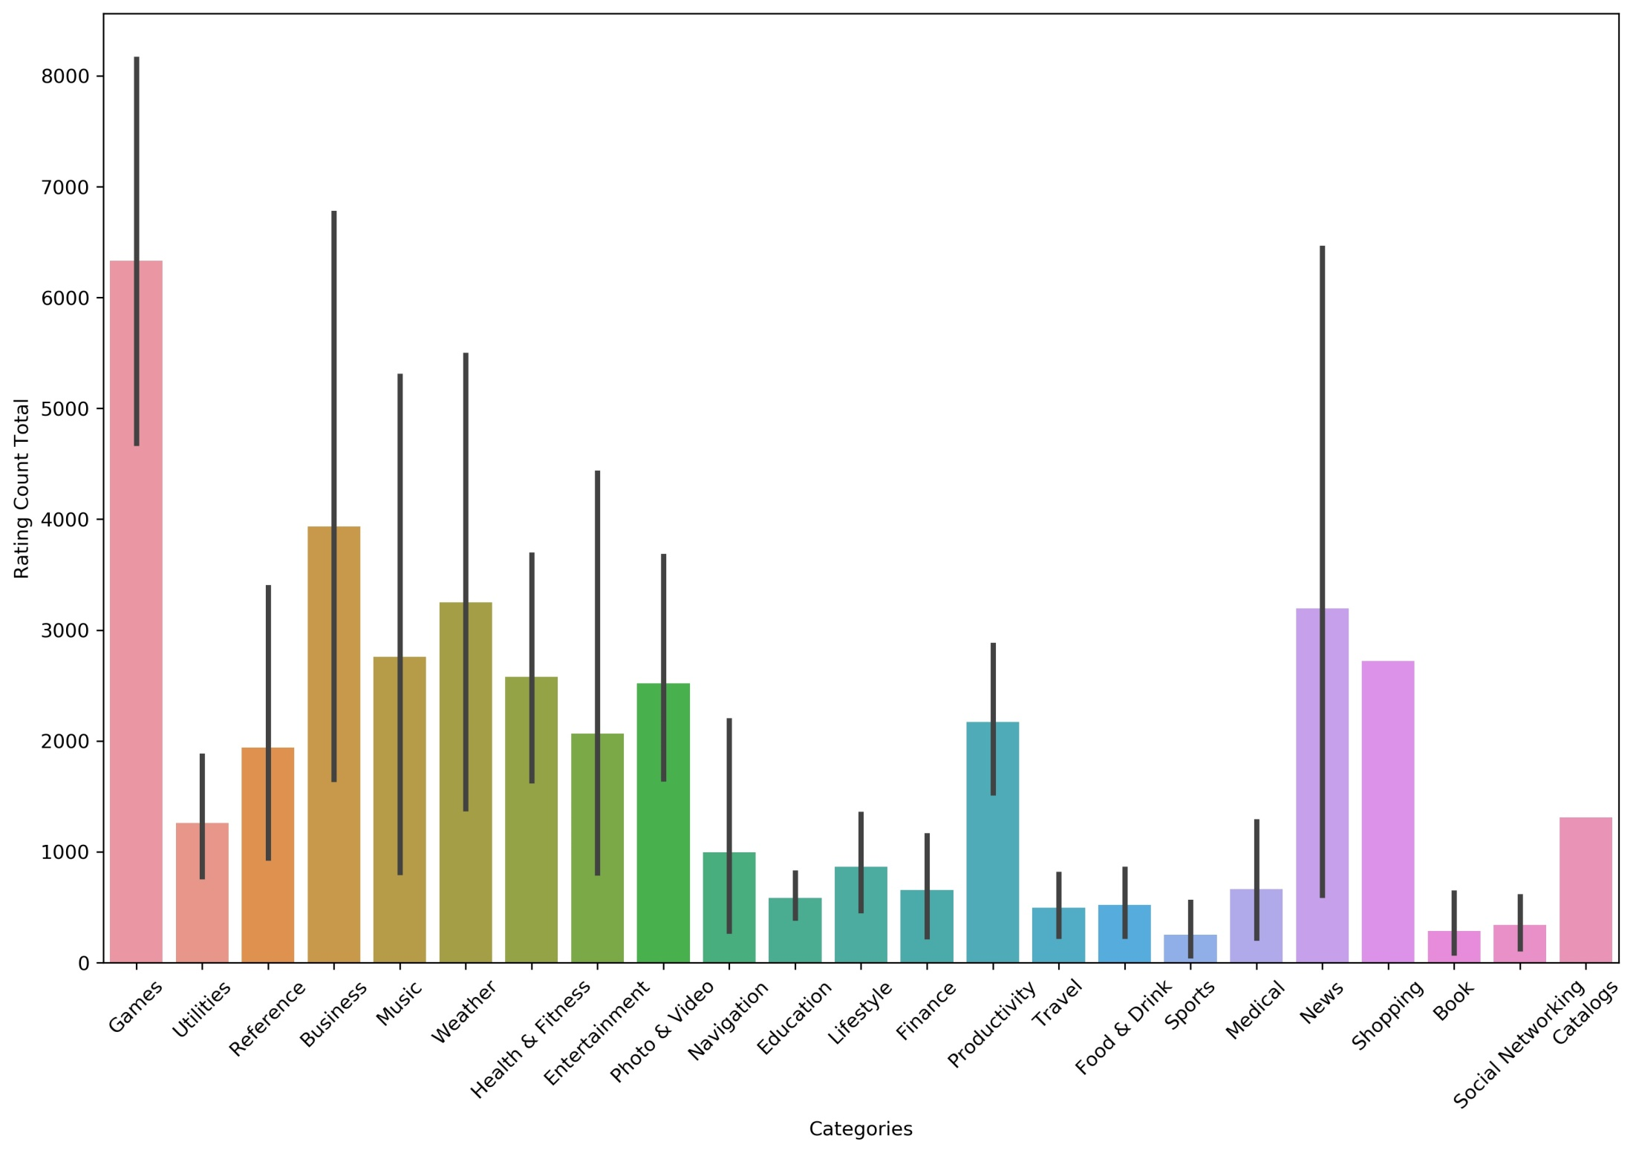

Slide 5
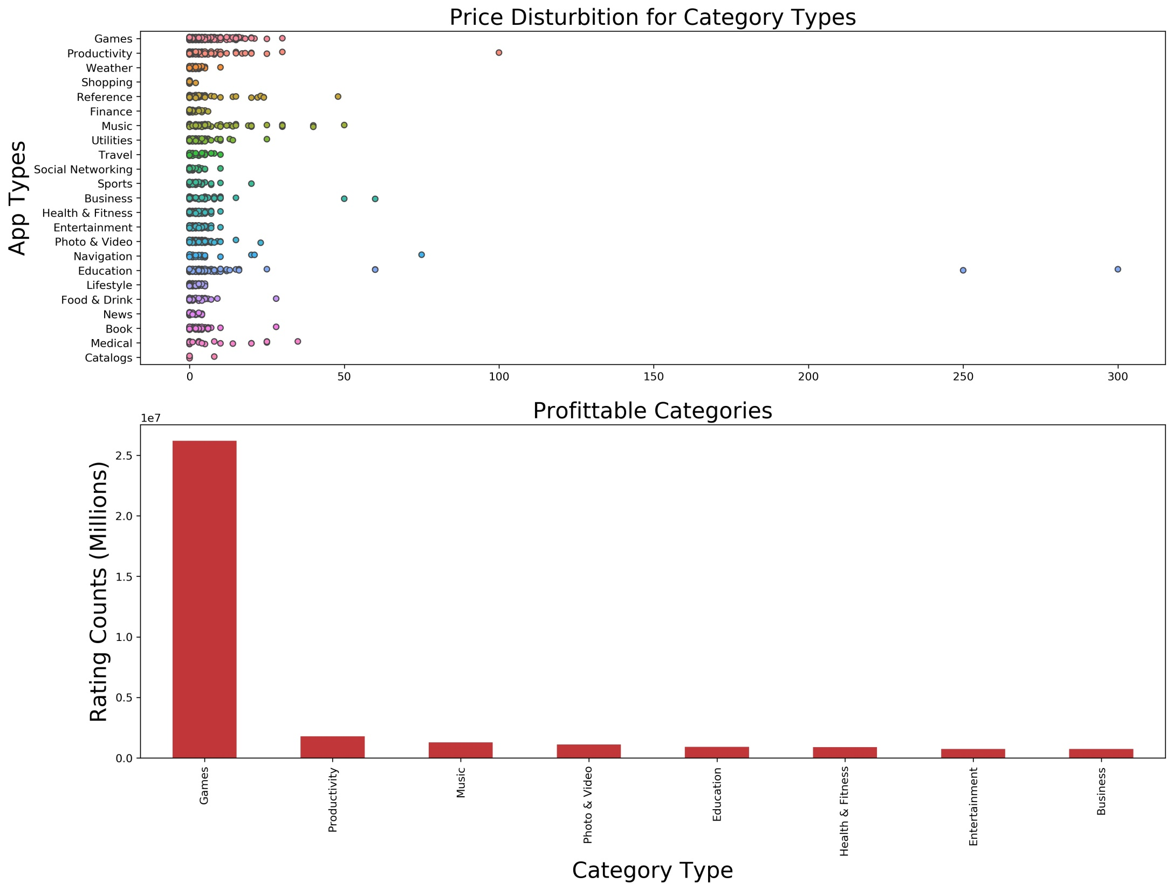

Slide 6
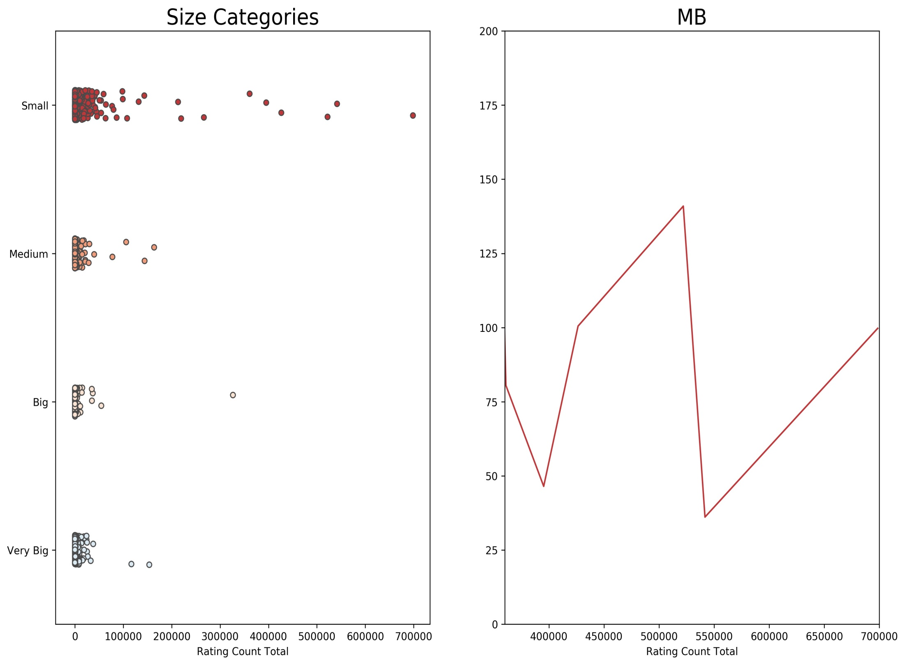

Slide 7
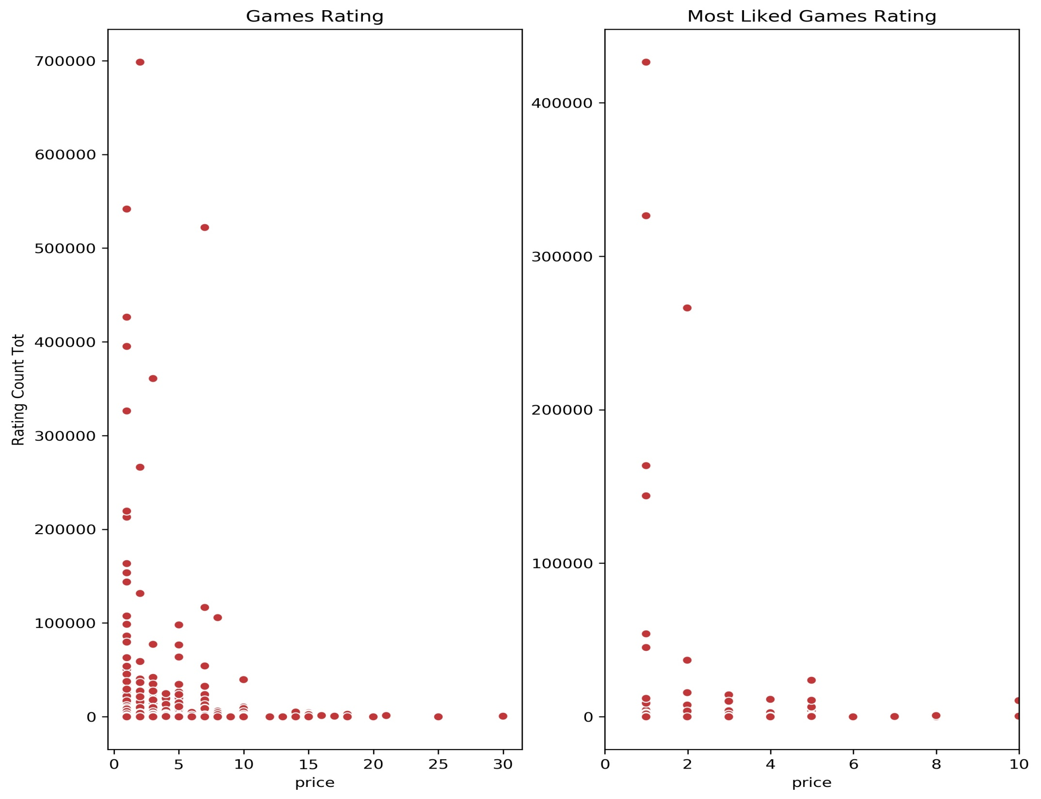

Slide 8
Recommendation
1
The Best Candidate of App Category: GAMES
The highest MB that should be selected: 100
Best Price Range: Min 1 USD Max 2 USD
2
3

Slide 9
FUTURE WORKS
1. Which words should I use for an effective description? Do people look at the description while downloaded the application? Which words are the most mentioned in the definitions?
2. What is the effect of supported languages on the number of rating?
3. Sentimental analysis of user comments

